Slide 1

Solar Power Plant design
Lecture – 18 : Pvsyst

Slide 2
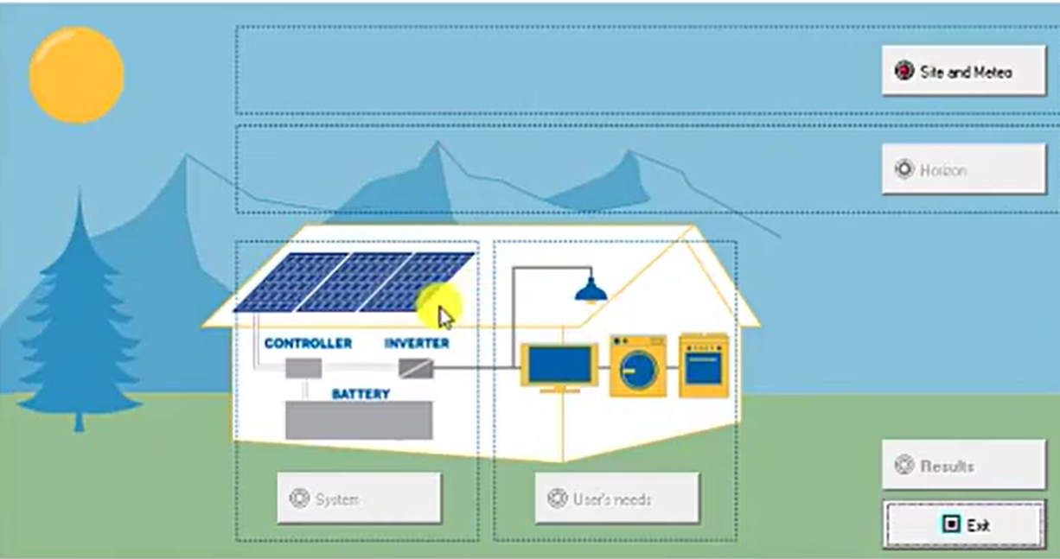

Slide 3
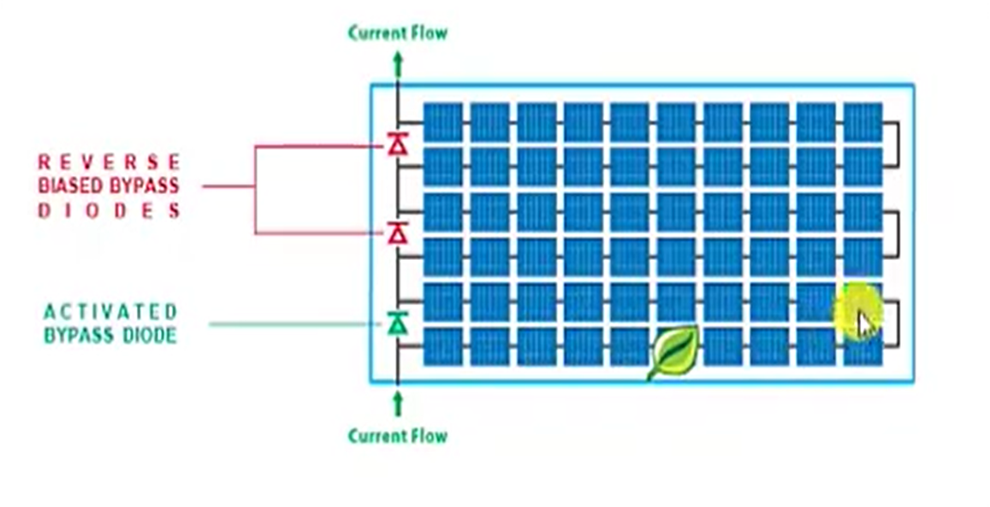

Slide 4
Thank You

